Slide 1

Diet plan C++ project
BY:
Viren Rathod
Saurin Patel
Meet Vaghasia

Slide 2
Aim of our project
Aim of our project is to provide a better diet plan, based on some factors:
Gender (Male/Female)
Age Group
Weight
Based on all these factors a diet plan with exercises will be provided.

Slide 3
Modules:
Login() : This function gives access to the program if correct details are entered.
Register and Login system (file management)
It have 3 options
Login
Register
Forgot Credentials
Choice(): This function will ask Gender.

Slide 4
Male_choice() or Female_choice():
Based on gender selection appropriate function will be executed.
And this function will take input of weight as well as age. And according to the parameters and inputs an output will be shown i.e. Underweight , Overweight , Fit.
In Female choice we have provided a diet for pregnant women too, a different diet will be provided for it.
Diet plan and Exercise for respective cases
(underweight, overweight, and fit)

Slide 5
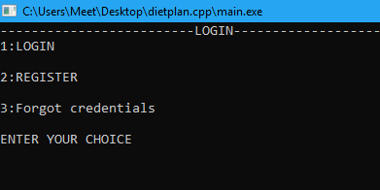
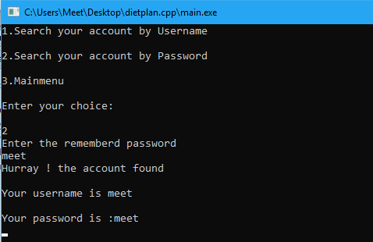
Some Screenshots:

Slide 6
Some Screenshots:

Slide 7
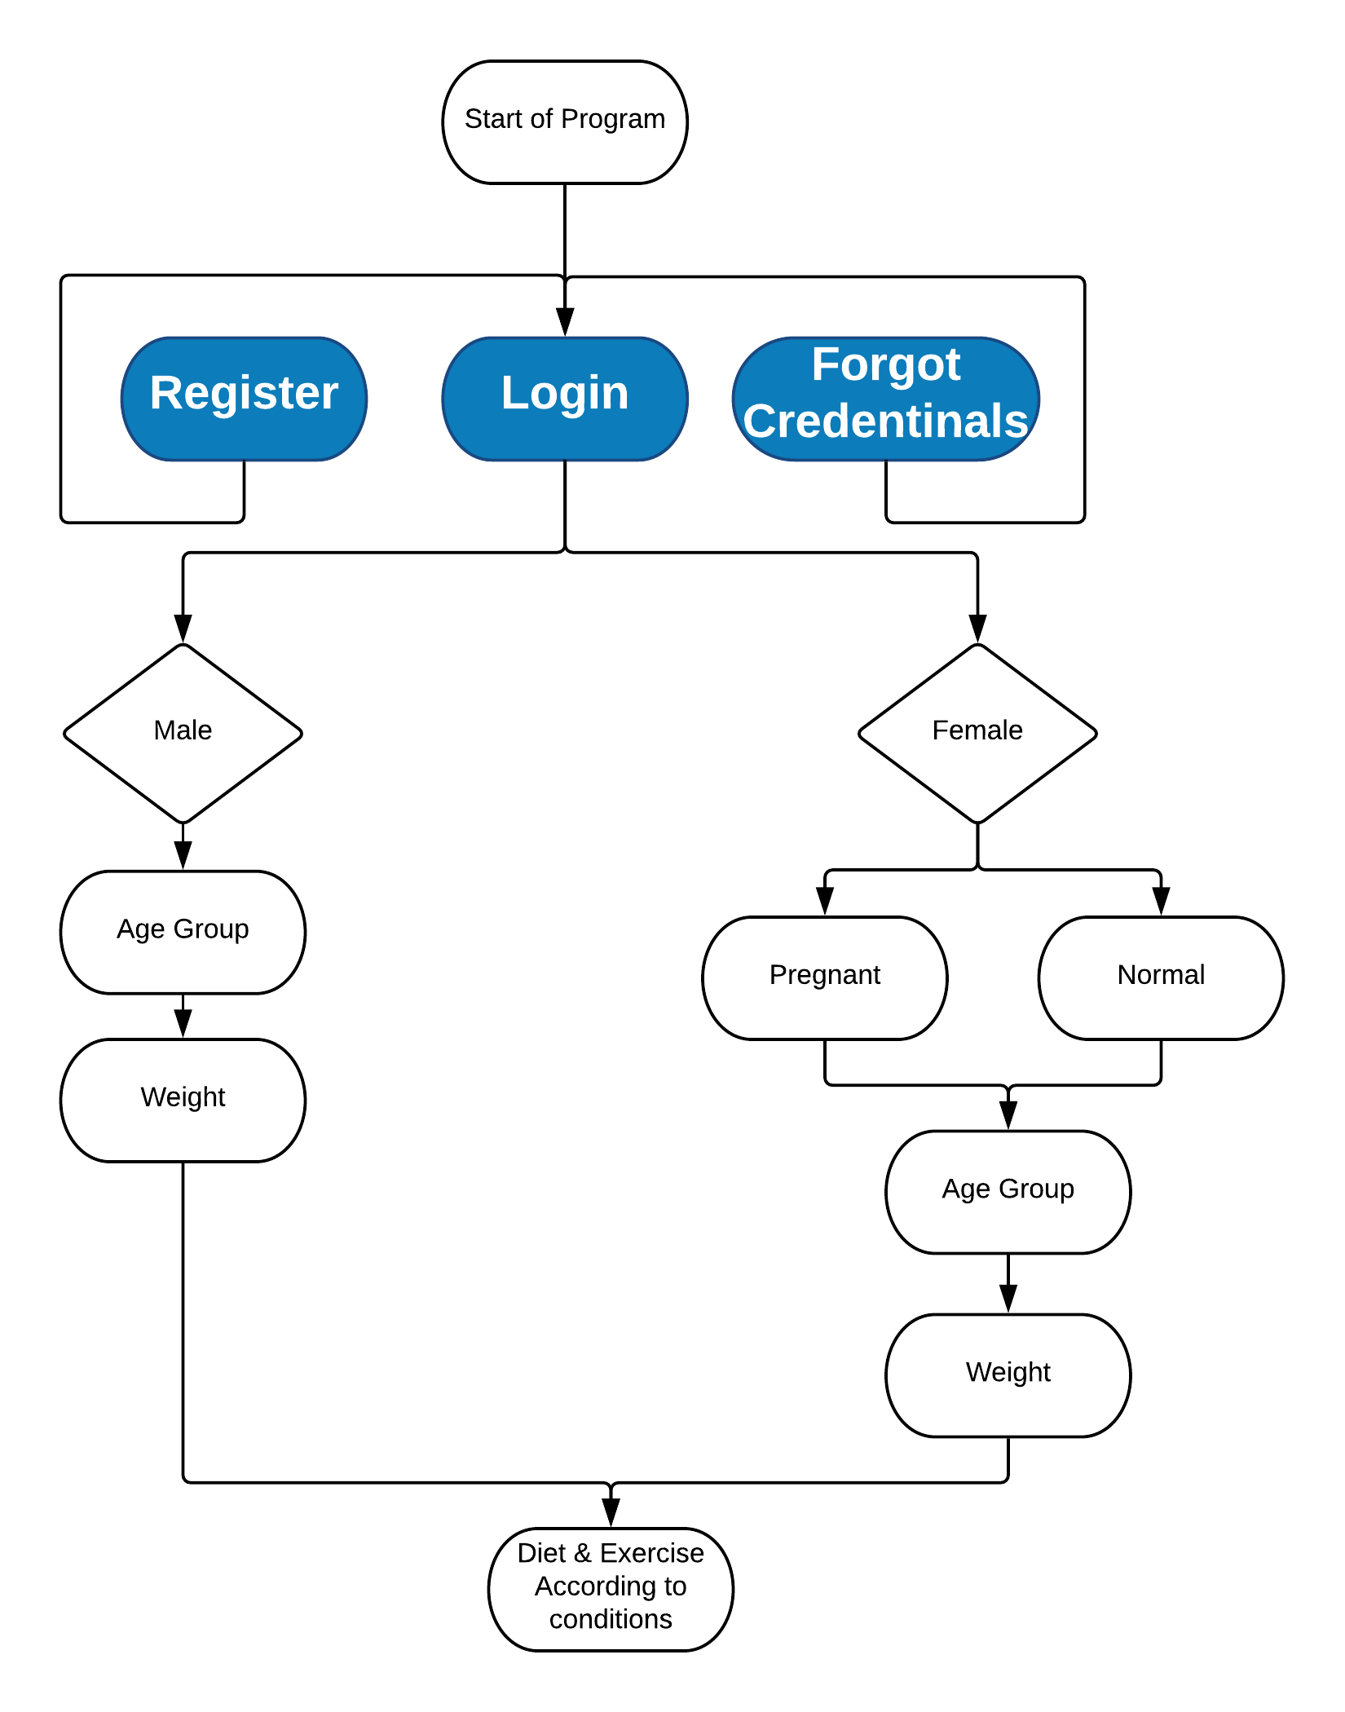
Flowchart:

Slide 8
Thank You நன்றி.

